Slide 1


BUSINESS COMMUNITY MEETINGS
OCTOBER 19, 2023
RETAIL
Information Breakout Session

Slide 2

PRESENTATION
  Bertrand Piller
  Senior Manager, Carnival Corporation
CelebrationKeyGrandBahama.com
Retail@carnivalgrandport.com

Slide 3
Destination Introduction

Slide 4
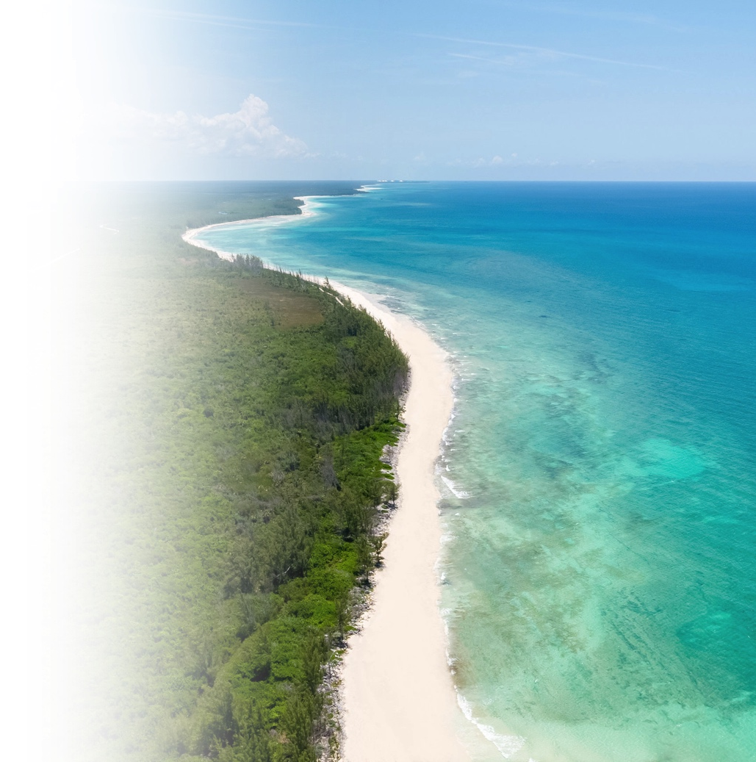
Vision
A Bahamian-inspired new cruise destination, this will be The Bahamas and Caribbean’s largest and most spectacular cruise destination
Reintroduces Grand Bahama to the world as a premier cruise and tourism destination
A gateway to Grand Bahama offering guests a uniquely Bahamian experience with many exciting features and amenities
Creating a new and exciting economic engine for Grand Bahama Island

Slide 5
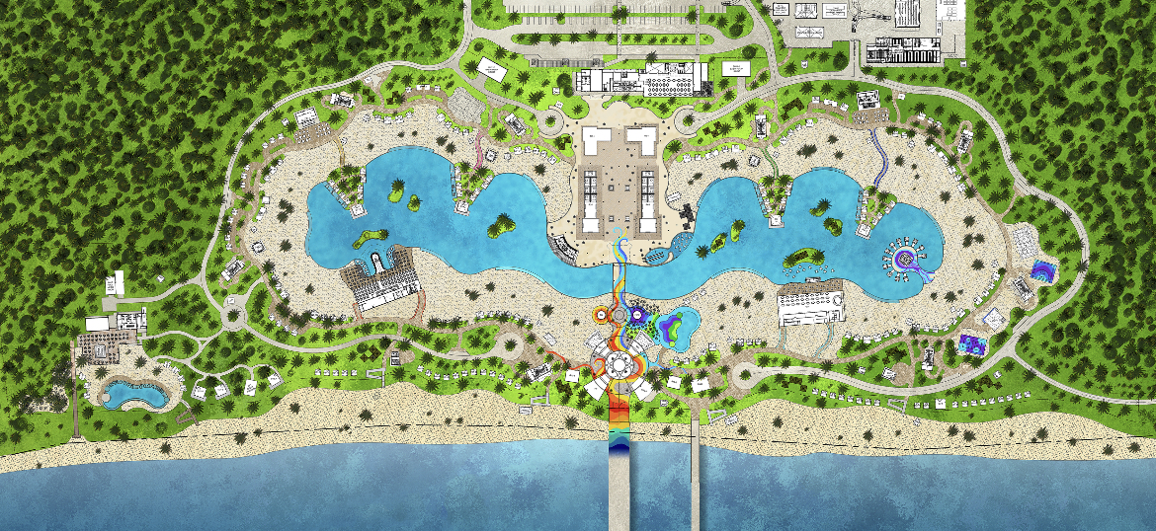
Project Details
329 Acres of which a significant area will remain undeveloped
A pier accommodating two Excel-class ships (not currently calling on the island)
Guests will be able to explore Grand Bahama by way of sea or land
Amenities interwoven with Bahamian design & culture, offered to guests and crew
The destination will also feature an area designated as a nature reserve and a water amenity
Along with many Bahamian-operated retail, food and beverage options

Slide 6
Examples of Retail in our Regionally Operated Ports

Slide 7
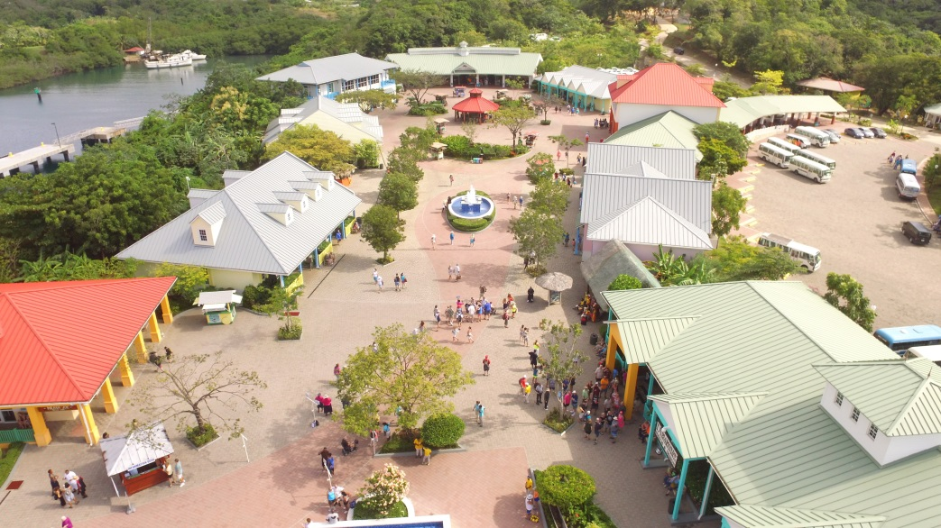
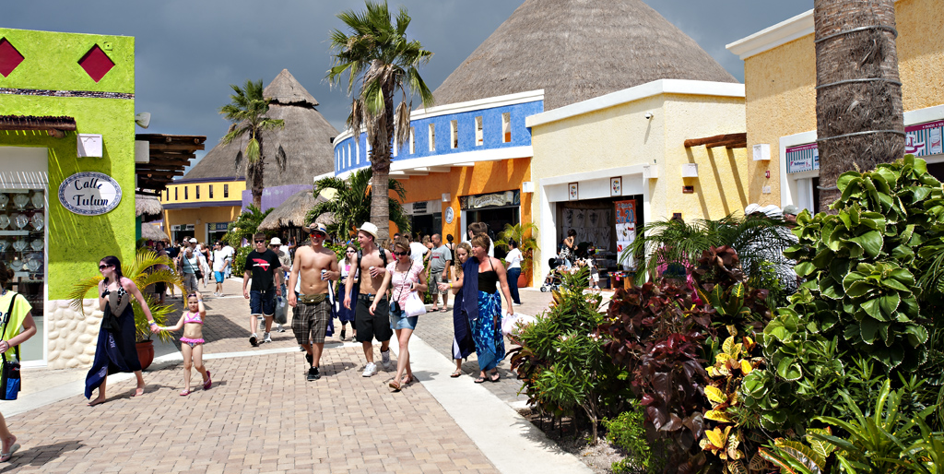
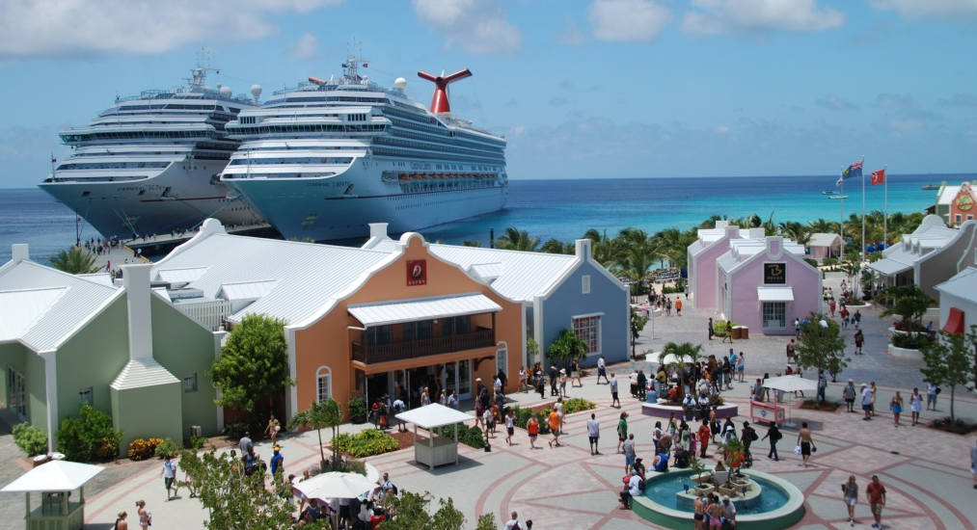
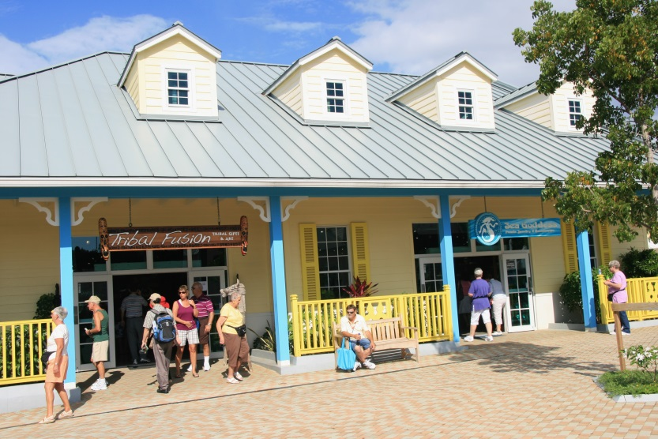
Retail Examples at our Regionally Operated Ports.
Mahogany Bay
Puerta Maya
Grand Turk
Amber Cove

Slide 8
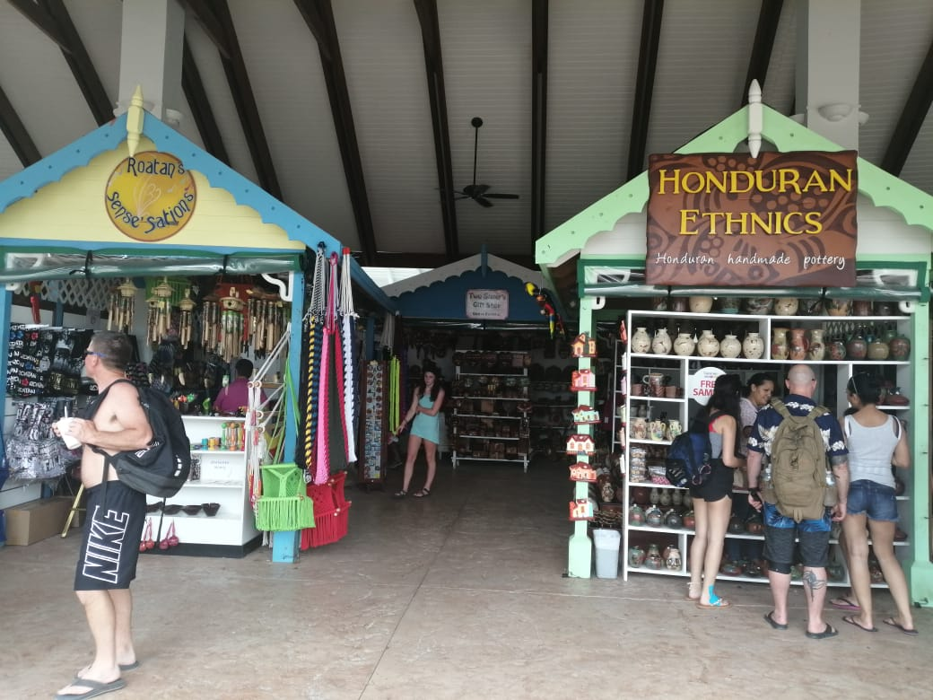
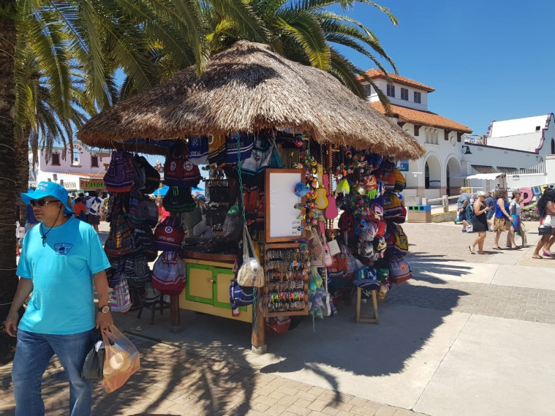
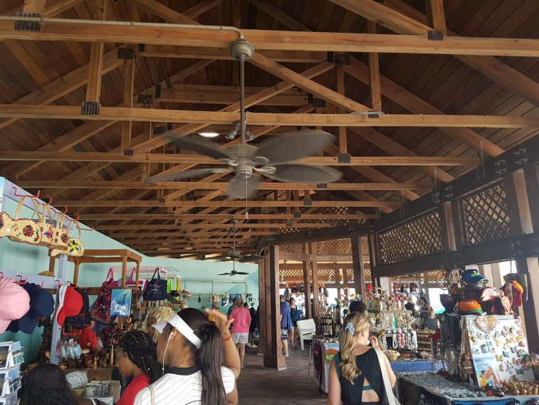
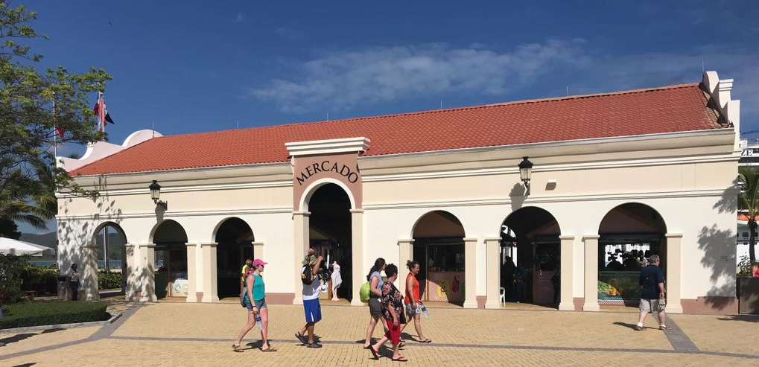
Local Markets & Kiosks Examples at our Regionally Operated Ports.
Mahogany Bay
Puerta Maya
Grand Turk
Amber Cove

Slide 9
Retail Opportunities at Celebration Key

Slide 10
Celebration Key – Guests & Crew spend
Per FCCA 2018 report¹ (f-cca.com, Publications, Research & Statistics), the spend per guest & crew that visited the Bahamas, as well as the destination with the highest total spend in the Caribbean (U.S. Virgin Islands) was as follows:
Surveys were conducted by FCCA member cruise lines that called at the destination and were returned to a 3rd party (BREA) for tabulation. | Bahamas |  | USVI
 | Guests | Crew | Guests | Crew
Estimated % disembarking per Bahamas Tourism Authority and Cruise Lines (for crew) | 82% | 45% | 85% | 42%
Total Spend per Individual that Disembarked (select categories only)
Watches & Jewelry | $57.45 | $1.46 | $104.22 | $4.51
Clothing | $11.09 | $2.58 | $11.63 | $10.79
Other Purchases | $9.55 | $10.16 | $10.28 | $11.87
Local Crafts & Souvenirs | $9.13 | $1.53 | $4.65 | $1.79
Retail Purchase of Liquor | $2.50 | $0.32 | $2.92 | $0.32
Perfumes & Cosmetics | $0.82 | $2.32 | $0.72 | $2.48
Taxis & Ground Transportation | $3.00 | $1.75 | $5.23 | $3.81
Total Spend per Individual that Disembarked | $131.95 | $54.90 | $165.42 | $60.12
¹Source: October 2018 BREA Economic Contribution of Cruise Tourism to the Destination Economies report, for the Florida-Caribbean Cruise Association and Participating Destinations (9 pages are Bahamas specific). Bahamas includes Nassau and Freeport.

Slide 11

Celebration Key - Retail Introduction
We have finalized the design of the destination and are about to start construction
Retail operation (~18,000 sq ft)
Various store sizes opportunities:
  Large stores (1,400 – 1,800 sq ft/store)
  Standard stores (450-600 sq ft/store, Air conditioned)
  Smaller outlets, including craft and artisanal markets, kiosks (70-180 sq ft / store, open but under roof)
  Various locations throughout the Destination
Investment level will depend on store size
Vision to focus on Bahamian brands or new concepts for Celebration Key
Proper licenses required, including GBPA

Slide 12
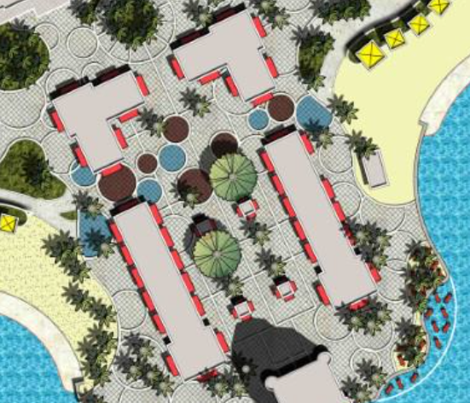
Retail Village
Retail footprint is not planned to be dense.
Retail Differentiation: Bahamian Inspired.
Different sizes: Anchors, “Standard” and Artisan Market.

Slide 13
50+ Retail Outlets (ranging from 100 to 2K sq. ft.)

Slide 14
Celebration Key - Retail Vision
We plan to negotiate and execute a series of commercial lease agreements with various operators
The terms of the lease agreements will vary depending on the concept and the level of investment of each operator
Shorter term lease agreements for smaller market locations are being explored
Each building and store has been designed to reflect Bahamian authenticity
Guests will be charged for all purchases via retailer’s own payment system (cash / cc)

Slide 15
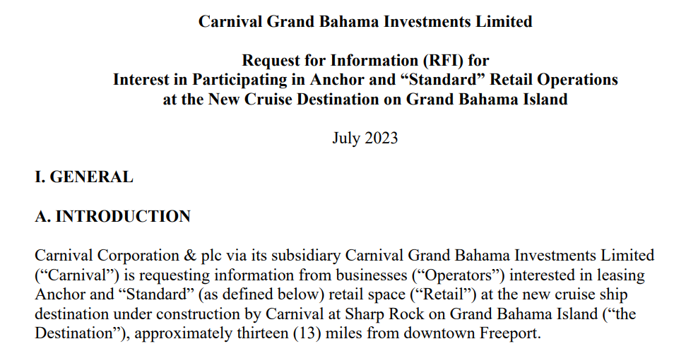
Celebration Key - Retail Selection Process
Request for Information (RFI) CURRENTLY AVAILABLE
Request for Proposal (RFPs) are made available via our website
RFPs, selection criteria and corresponding timeline will be different by category and/or size of retail
Project team will review all submissions and contact shortlisted companies to negotiate and contract the space.
CelebrationKeyGrandBahama.com / Opportunities / RFQ/RFP
CelebrationKeyGrandBahama.com
Retail@carnivalgrandport.com

Slide 16
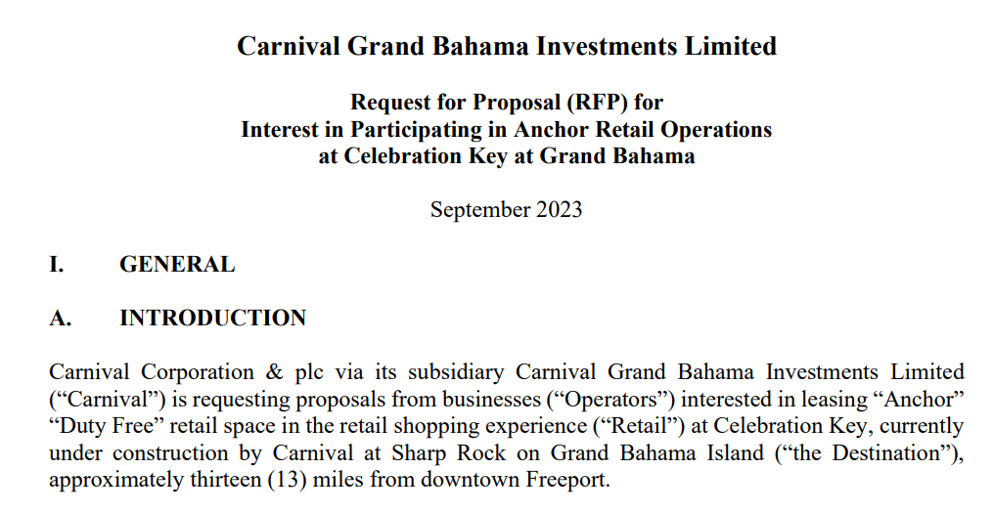
Celebration Key - Retail Selection Process & Employment Opportunities
TIMELINE: RFPs to start becoming available depending on store size:
  Anchor Stores: NOW – DEADLINE Nov 17
  Standard Stores: Winter 2023 / Spring 2024
  Market/Kiosks: Fall / Winter 2024
Retail operators will start to gain access to the cruise port to work on space and build out starting Winter/Spring 2024/2025
EMPLOYMENT OPPORTUNITIES
  Indirect Construction / Build out opportunities (with local contractors) starting soon.
  Indirect Employment opportunities with Retail Operators, starting Spring 2025
CelebrationKeyGrandBahama.com / Opportunities / RFQ/RFP
CelebrationKeyGrandBahama.com
Retail@carnivalgrandport.com

Slide 17
BUSINESS COMMUNITY MEETINGS
OCTOBER 19, 2023
RETAIL
Information Breakout Session

